Slide 1
Simple simulations

Slide 2
Headline/overview/conclusion
Simple PL-based strategies are not sufficient to fully explain behaviour, if one plots by conflict
Plotting by Vchosen is not very helpful – doesn’t discriminate between the different simple strategies
Details
Simulations are built stochastically, using the plot_explorebeh scripts
Note: PP scores here are not the residuals after regressing out PL, unless explicitly marked in section.

Slide 3
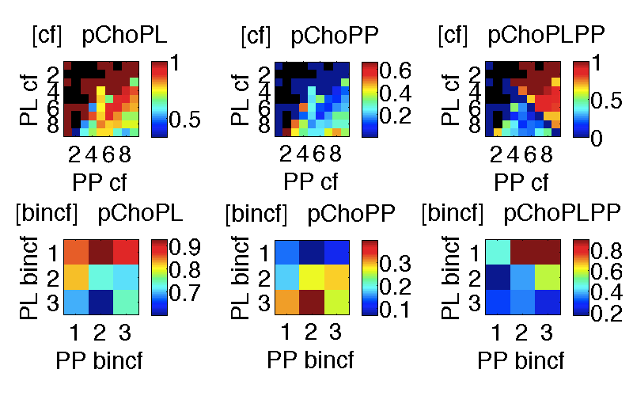
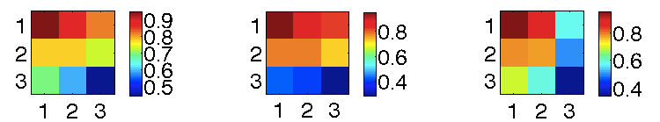
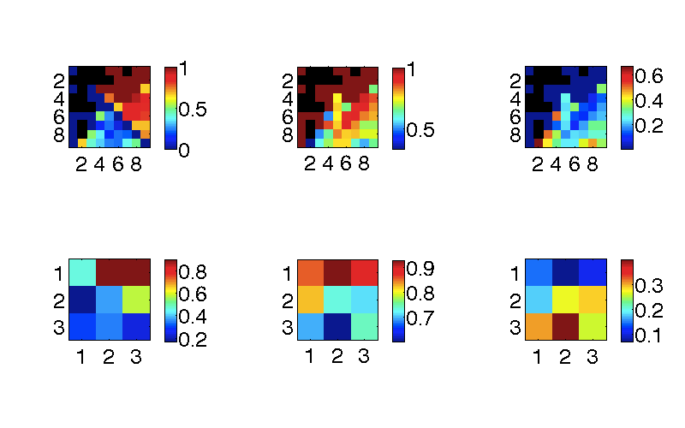
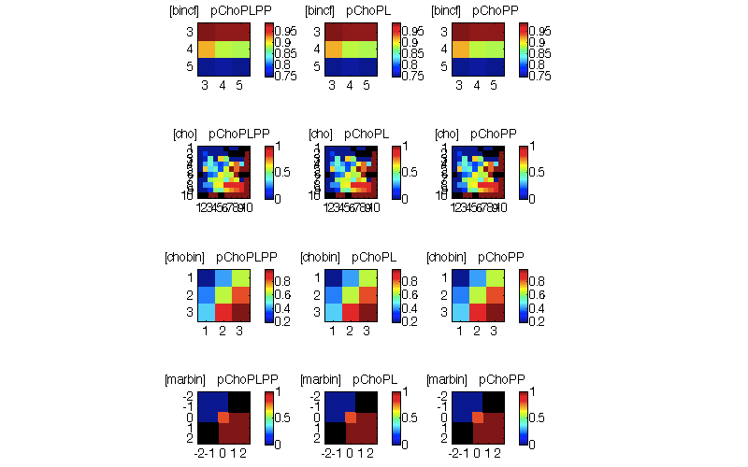
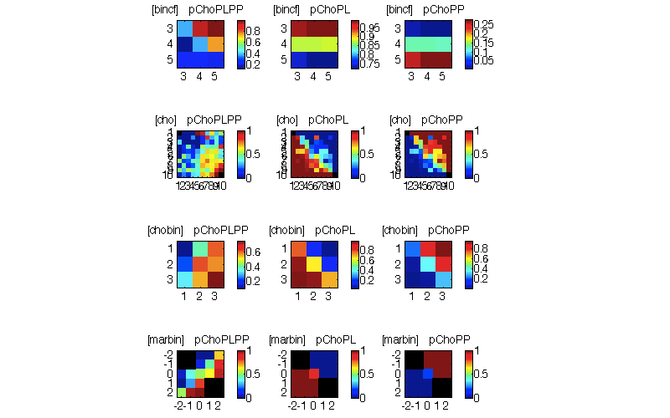
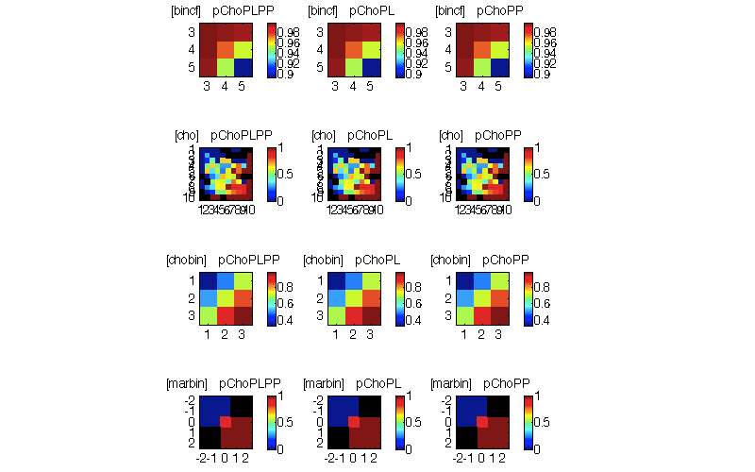
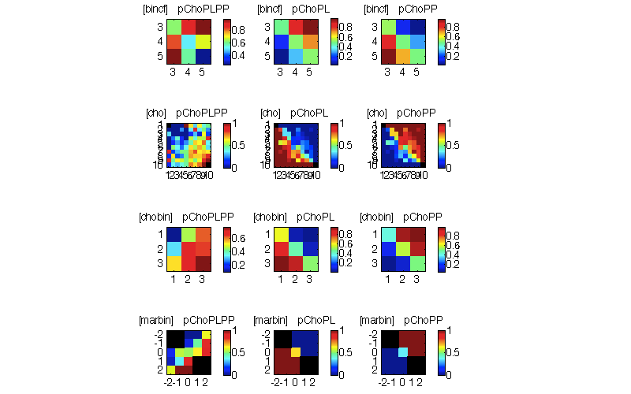
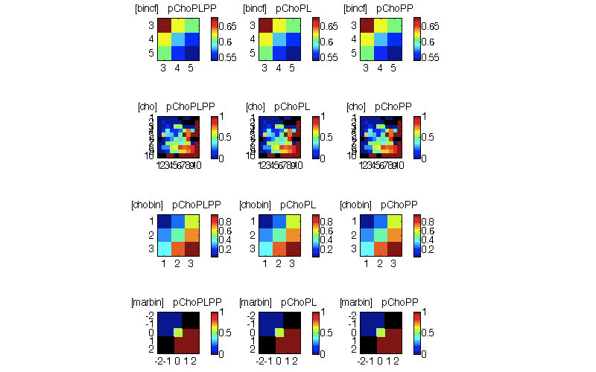
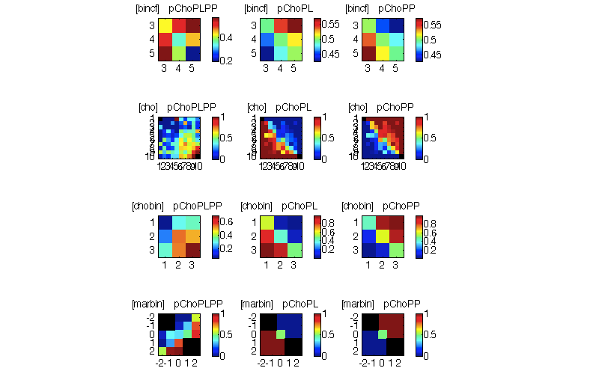
Binned by conflict
CC trials
IC trials
p(Choose agree w PLPP)
p(Choose agree w PL)
p(Choose agree w PP)
p(Choose agree w PLPP)
p(Choose agree w PL)
p(Choose agree w PP)
Observed data
X
Choose best PL
X
Choose best PLPP
Choose better PL/PLcf + PP/PPcf
Choose PL is insufficient to produce observed behaviour
When binned according to conflict, conflict appears to be important in producing the overall pattern of behaviour
Notes:
Simulations here are stochastic
- Observed pattern of data = increase pChoMaxPLPP as you decrease conflict in the PL & PP domains
- This is good in that it validates the PLPP scores. But, is there utility in the LCA?
X and y labels in data is different from simulations for unimportant reasons

Slide 4
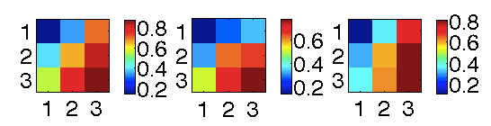
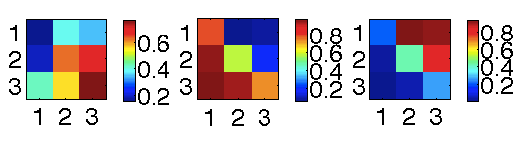
Binned by VChosen
Not very useful
X
CC trials
IC trials
p(Choose agree w PLPP)
p(Choose agree w PL)
p(Choose agree w PP)
p(Choose agree w PLPP)
p(Choose agree w PL)
p(Choose agree w PP)
Observed data
Choose best PL
Choose best PLPP
Choose better PL/PLcf + PP/PPcf
Plotting by VChosen isn’t very discrimitive
One still gets an effect along the PP (horizontal) axis even if one just adopts a choose-PL strategy
WHY? Remember that in CC trials, ChooseMaxPP ≈ ChooseMaxPL (minus draws)
Note that we would never expect to find solid horizontal stripes, just because of noise in PP scores (even if they are not incorporated into decision)
Possibly because of (hidden) correlations between PL and PP scores

Slide 5
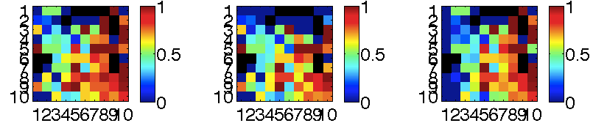
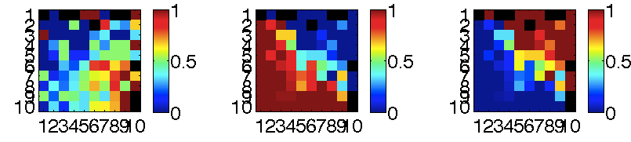
Binned by Vchosen (un-binned)
Not very useful
CC trials
IC trials
p(Choose agree w PLPP)
p(Choose agree w PL)
p(Choose agree w PP)
p(Choose agree w PLPP)
p(Choose agree w PL)
p(Choose agree w PP)
Observed data
Choose best PL
Choose best PLPP
Choose better PL/PLcf + PP/PPcf
Patterns here are hard to discern. Choosing-PL does produce AVFo-PP → from PL-PP correlations, probably
Notes:
The reason why cells that were empty in the observed data have sometimes gotten filled in is because, remember, the simulations apply a different choice rule. This means that cells that were previously unfilled (never == a chosen event) are now chosen. This filling in of empty cells will only happen for measures that are choice-variant

Slide 6
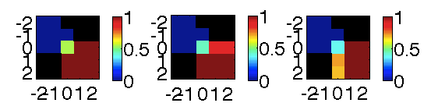
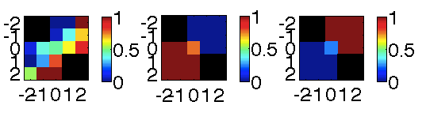
Binned by Vchosen>Vbest Unchosen
Not very useful
CC trials
IC trials
p(Choose agree w PLPP)
p(Choose agree w PL)
p(Choose agree w PP)
p(Choose agree w PLPP)
p(Choose agree w PL)
p(Choose agree w PP)
Observed data
Choose best PL
Choose best PLPP
Choose better PL/PLcf + PP/PPcf
- These plots do not distinguish between the choice strategies

Slide 7
Running simulations after having PL regressed out of PP (PP=residuals, rescaled and rounded)

Slide 8
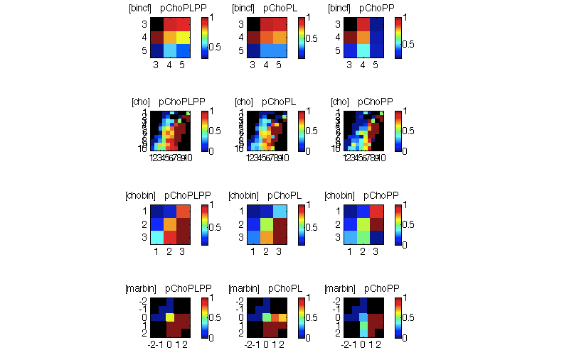
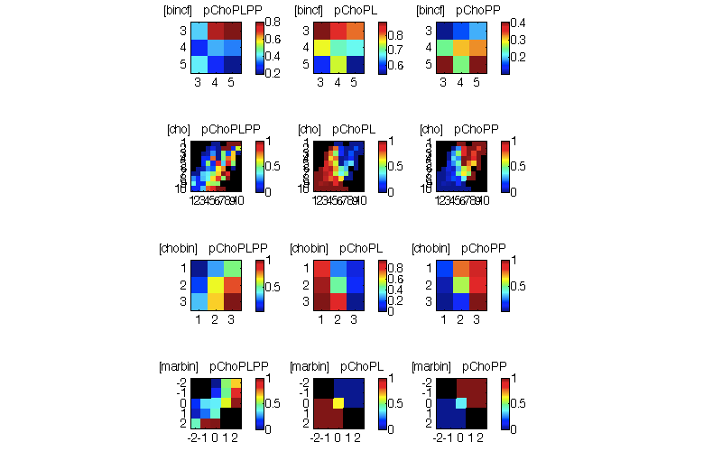
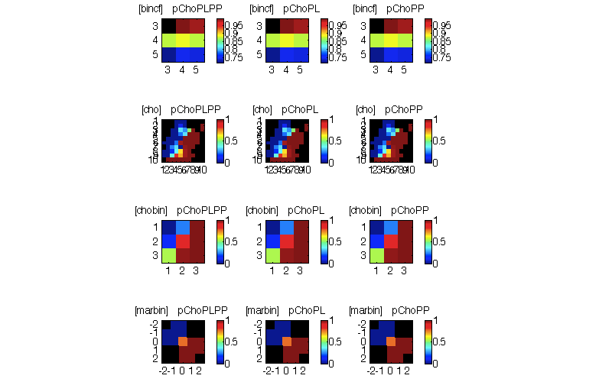
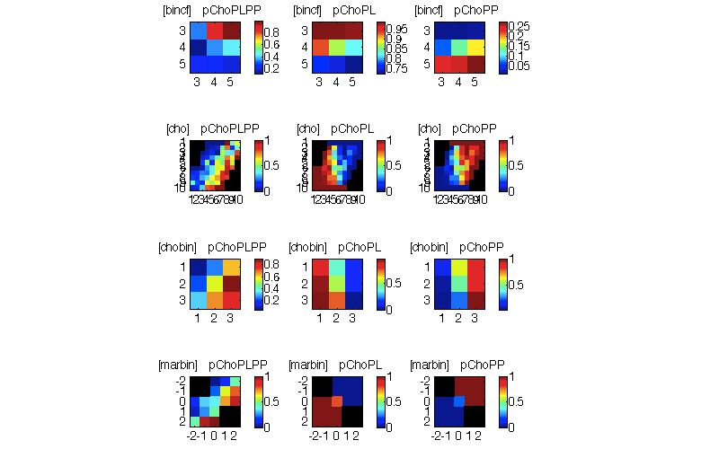

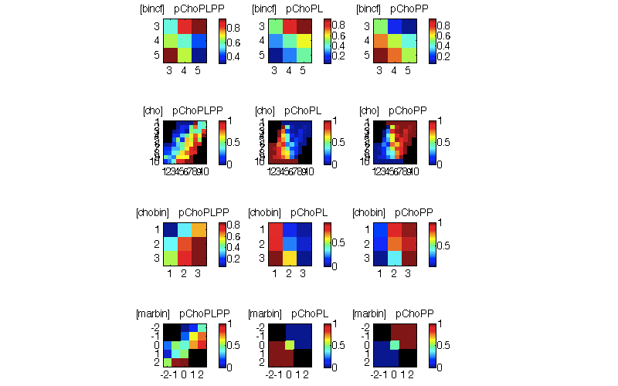
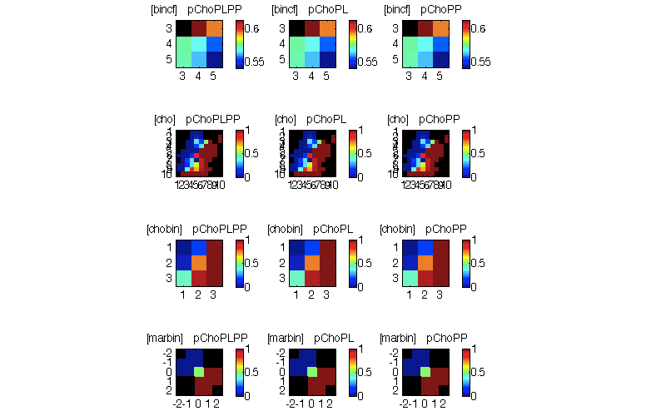
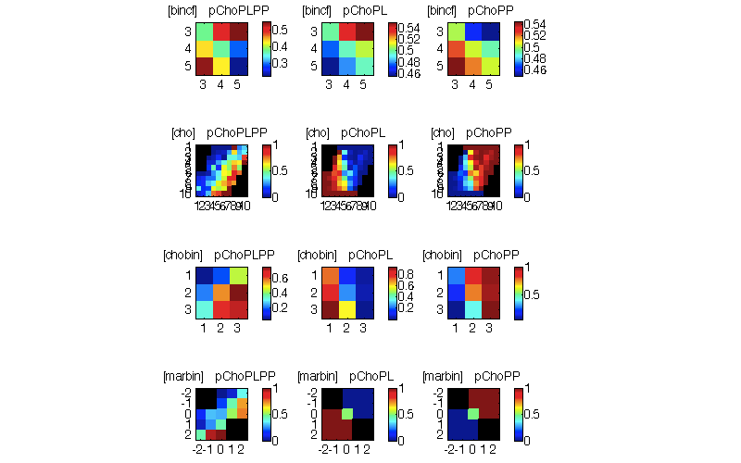
Binned by conflict
PP has PL decorr
CC trials
IC trials
p(Choose agree w PLPP)
p(Choose agree w PL)
p(Choose agree w PP)
p(Choose agree w PLPP)
p(Choose agree w PL)
p(Choose agree w PP)
Observed data
X
Choose best PL
X
X
Choose best PLPP
X
Choose better PL/PLcf + PP/PPcf
- Decorrelating PL from PP somewhat distorts the extent to which PLcf + PP/cf predicts choice. May make the pattern harder to discern, though it is more statistically kosher.

Slide 9
Binned by Vchosen
PP has PL decorr
Not very useful
CC trials
IC trials
p(Choose agree w PLPP)
p(Choose agree w PL)
p(Choose agree w PP)
p(Choose agree w PLPP)
p(Choose agree w PL)
p(Choose agree w PP)
Observed data
Choose best PL
Choose best PLPP
X
Choose better PL/PLcf + PP/PPcf
Plotting by Vchosen is not very discriminative – all strategies appear to (more or less) give rise to the observed behaviour

Slide 10
Binned by Vchosen (un-binned)
PP has PL decorr
Not very useful
CC trials
IC trials
p(Choose agree w PLPP)
p(Choose agree w PL)
p(Choose agree w PP)
p(Choose agree w PLPP)
p(Choose agree w PL)
p(Choose agree w PP)
Observed data
Choose best PL
Choose best PLPP
X
Choose better PL/PLcf + PP/PPcf
Plotting this way is not discriminative between strategies
Notes:
The reason why cells that were empty in the observed data have sometimes gotten filled in is because, remember, the simulations apply a different choice rule. This means that cells that were previously unfilled (never == a chosen event) are now chosen. This filling in of empty cells will only happen for measures that are choice-variant

Slide 11
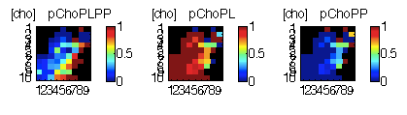
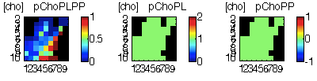
Note: why does a cho-PL strategy not lead to never choosing PP in the IC trials?
Basically probably because of (a) residual correlation between PL & PP, and (b) beta=0.8 (chosen to allow for range in other plots)
IC trials, PP=PP-regressed-PL
b=8
b=80
For lack of time, I haven’t completely tracked this down right to its absolute source yet. But I think it’s probably okay – i.e. there isn’t some egregious bug

